Slide 1
Lecture 6
Dynamic data structure
A “link list”

Slide 2
Array versus link list
An array is a structure whose size is fixed at run time; e.g. empdb
In an array to delete a record it has to be marked as deleted.
If the array is full cannot add any more records
These restriction are overcoming using a dynamic “link List” of records: the size can be increased/decrease during run time.
This requires the use of malloc to create a new node and free to remove a dynamically created note
It also requires some way of linking these nodes :
Hence a structure refer to as a node

Slide 3
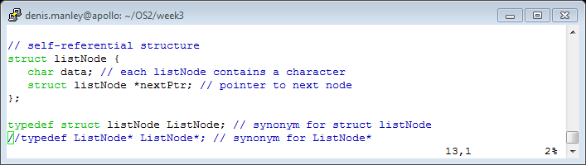

The node
A node had two parts:
one for containing data (an integer; an employee record….)
A pointer to another node (link between nodes)
The following c code is a struct for such a node: data in this example is only an int

Slide 4
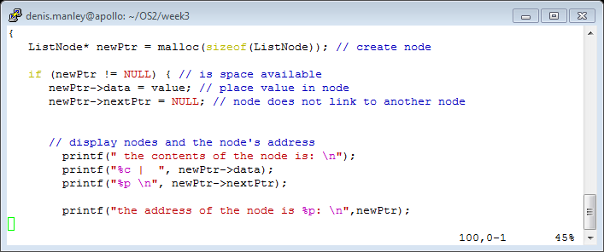
Dynamically create a node
Create node and insert data using Malloc:
Display the contents of the node and the address of the node
Refer to ListNode.c

Slide 5
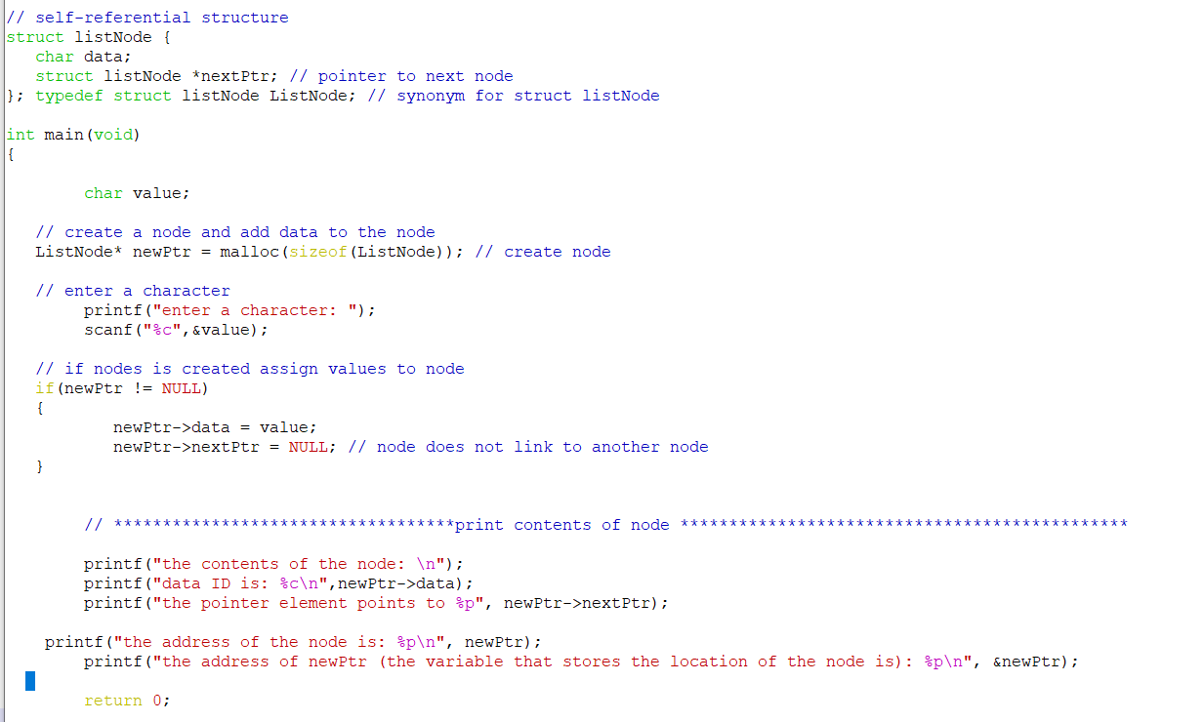
ListNode.c sample code

Slide 6
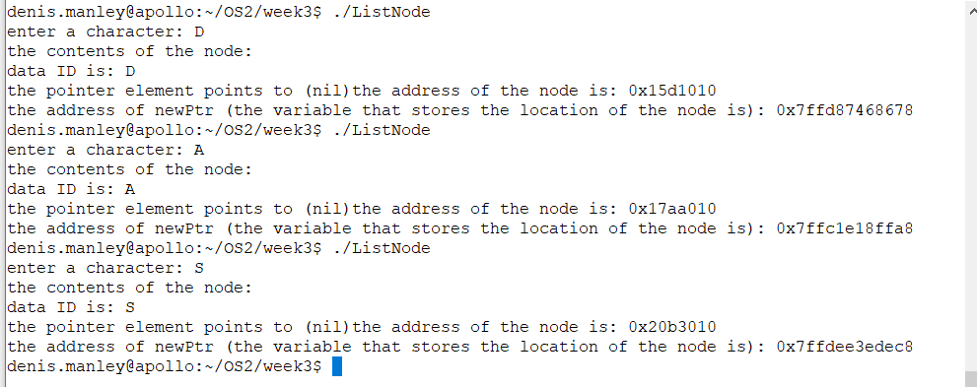
3 sample runs of ListNode.c

Slide 7
Class Question
What is stored in newPtr
In statement newPtr -> value = 8
what data type is stored in newPtr ?
In statement newPtr -> nextPtr = NULL
What data type is nextPtr ?
In statement newPtr -> data = NULL
What data type is data?

Slide 8
Linked Lists
A
B
C
∅
Head
A linked list is a series of connected nodes
Each node contains at least
A data field (any data type; e.g. int)
Node Pointer field: A pointer variable that stores the address of the the next node in the list
It has an address (&node)
Head: “pointer” to the first node
The last node points to NULL

Slide 9
Link List Overview
Linked lists: a set of interconnected nodes
Basic operations of linked lists
Insert, find, delete, print, edit….
Variations of linked lists
Stacks : e.g. the program/thread stack: (L.I.F.O.)
Queues: used for algorithms for scheduling processes to run on a CPU: (F.I.F.O.)

Slide 10
A Simple Linked List “Node” structure
Linked lists are made up of Nodes
Declare Node structure for each node
data: char-type data in this example
next: a pointer to the next node in the list
// c code to define listNode structure
struct listNode {
char data; // each listNode contains a character
struct listNode *nextPtr; // pointer to next node
}; /typedef struct listNode ListNode; // synonym for struct listNode

Slide 11
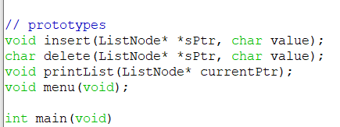
Operations on Linked List
sPtr is a “ListNode” double pointer variable
It must be a double pointer in order to pass a pointer by reference
currentPtr is a single pointer as we only pass the pointer by value
In this code the pointer variable stores the address of the first node of the list.

Slide 12
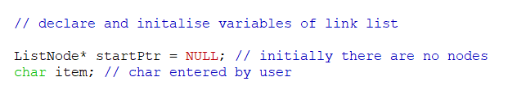

Code to initialise and call a insert fnt
The “double pointer” variable sPtr in the insert function is assigned the
Address of startPtr: a variable that stores the address of the first node in the list. If the list is empty in contains a NULL value.

Slide 13
Home Work Question
Write a C program that creates a new node which contains: an employee record (the data) and a pointer to a node.
Assign any values to the data element of the node and NULL to the pointer part
Display the contents of this node and the address of the node

